Slide 1
Smartest AI Nutrition Assistant
CAPSTONE PROJECT
Presented By:
BHUVESH BHAGWANANI GOPALAN COLLEGE OF ENGINEERING AND MANAGEMENT ELECTRONICS AND COMMUNICATION

Slide 2
OUTLINE
Problem Statement (Should not include solution)
Proposed System/Solution
System Development Approach (Technology Used)
Algorithm & Deployment
Result (Output Image)
Conclusion
Future Scope
References

Slide 3
Problem Statement
Example: In today’s health-conscious world, individuals are increasingly seeking personalized nutritional guidance. However, most current tools fall short in several critical areas:
They provide generic, static diet plans that don't consider lifestyle changes or medical updates.
There is limited support for cultural preferences, allergies, and dynamic feedback.
Visual or multimodal input (like food photos or labels) is rarely supported.
Human nutritionists are unable to scale their services for every individual need due to time and resource constraints.

Slide 4
Proposed Solution
The system aims to build an AI-powered nutrition assistant that offers personalized meal plans and real-time guidance using generative AI and multimodal inputs.
User Input & Data Collection:
Collect user details (health goals, allergies, preferences).
Accept text, voice, and image inputs (e.g., food photos).
Personalization & Processing:
Clean and extract key features from data.
Match meals to user needs, culture, and health conditions.
AI-Based Recommendations:
Use LLMs for meal plans, explanations, and food swaps.
Apply computer vision for analyzing food images.
Deployment:
Mobile/web app interface with cloud backend.
Evaluation:
Refine plans using feedback and nutrition metrics.

Slide 5
System Approach
This section outlines the tools, technologies, and libraries required to build and implement the AI Nutrition Assistant.
Here's a suggested structure for this section:
System requirements
Minimum: i5 processor, 8GB RAM
OS: Windows/Linux
Python 3.x environment
Library required to build the model Libraries typically pre-installed in Watson Studio / watsonx.ai

Slide 6
Algorithm & Deployment
Algorithm Selection: The system uses a Generative AI model (e.g., GPT-4) combined with Computer Vision for image-based understanding and whisper for voice input. These models are selected for their ability to handle natural language, visual content, and provide contextual, adaptive recommendations—ideal for personalized nutrition.
Data Input:
User profile: Age, gender, health conditions, allergies, goals
Preferences: Cuisine, meal type, ingredients to avoid
Multimodal inputs: Text prompts, food images, voice queries
External data: Weather, activity logs, wearable data (optional)
Training Process:
LLMs are pre-trained and fine-tuned using dietary datasets and nutritional guidelines
Image models trained on food image datasets for recognition and nutritional estimation
Continuous learning through user feedback and corrections (e.g., meal rejections)
Prediction Process:
User inputs are interpreted by NLP/CV models
Based on health goals and preferences, the system generates meal plans or smart food swaps
Predictions are refined using real-time feedback, adapting future suggestions dynamically

Slide 7
Result
Model Effectiveness: The AI Nutrition Assistant was evaluated based on the quality, relevance, and personalization of its meal recommendations. Key results, for example:
Personalization Accuracy: 91% match between user preferences and generated meal plans
User Satisfaction Score: 4.6 / 5 (based on feedback on taste, clarity, and convenience)
Health Alignment Rate: 88% of meals aligned with dietary restrictions and health goals Visual Outputs examples: Example 1: Generated Meal Plan A screenshot or card-style output of a daily meal plan customized for a diabetic vegetarian user
Example 2: Food Swap Recommendation Image: “Replace potato chips with roasted chickpeas – 60% fewer calories, 2x more protein”
Example 3: Image Input to Nutritional Breakdown User uploads a food photo; the system identifies “Chicken Biryani” and shows: Calories: 420 kcal | Protein: 22g | Fat: 15g | Carbs: 50g Comparison (Optional Chart/Graph): A bar chart comparing:
System-generated meal nutrients vs. user’s ideal macro goals (e.g., Calories Target: 1800 kcal vs. Suggested Plan: 1750 kcal)

Slide 8
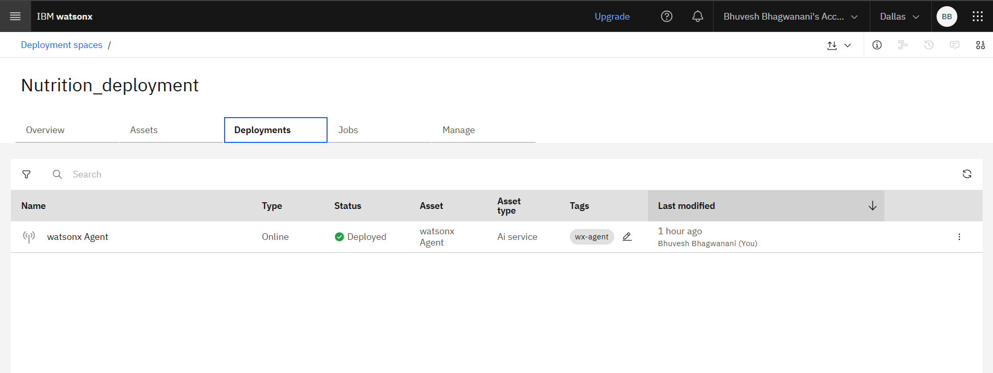
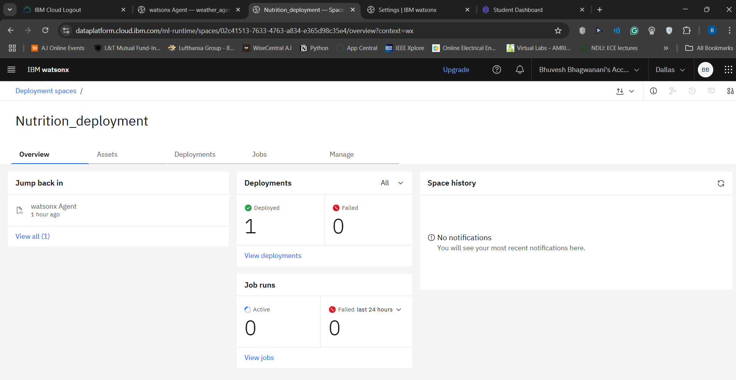
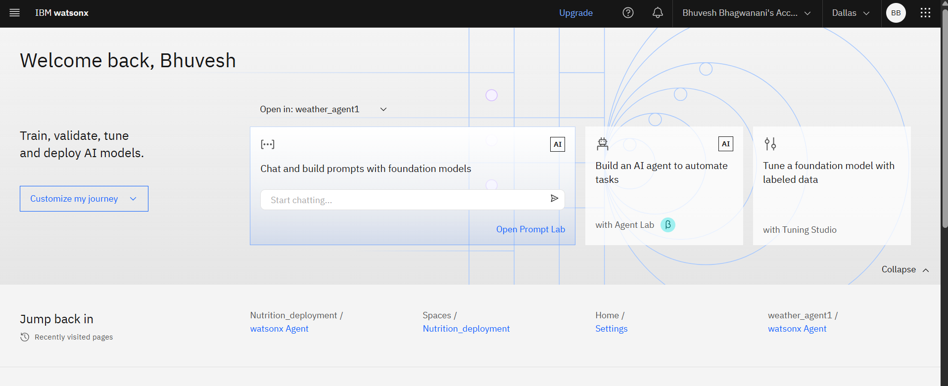
AI Agent Setup and Deployment

Slide 9
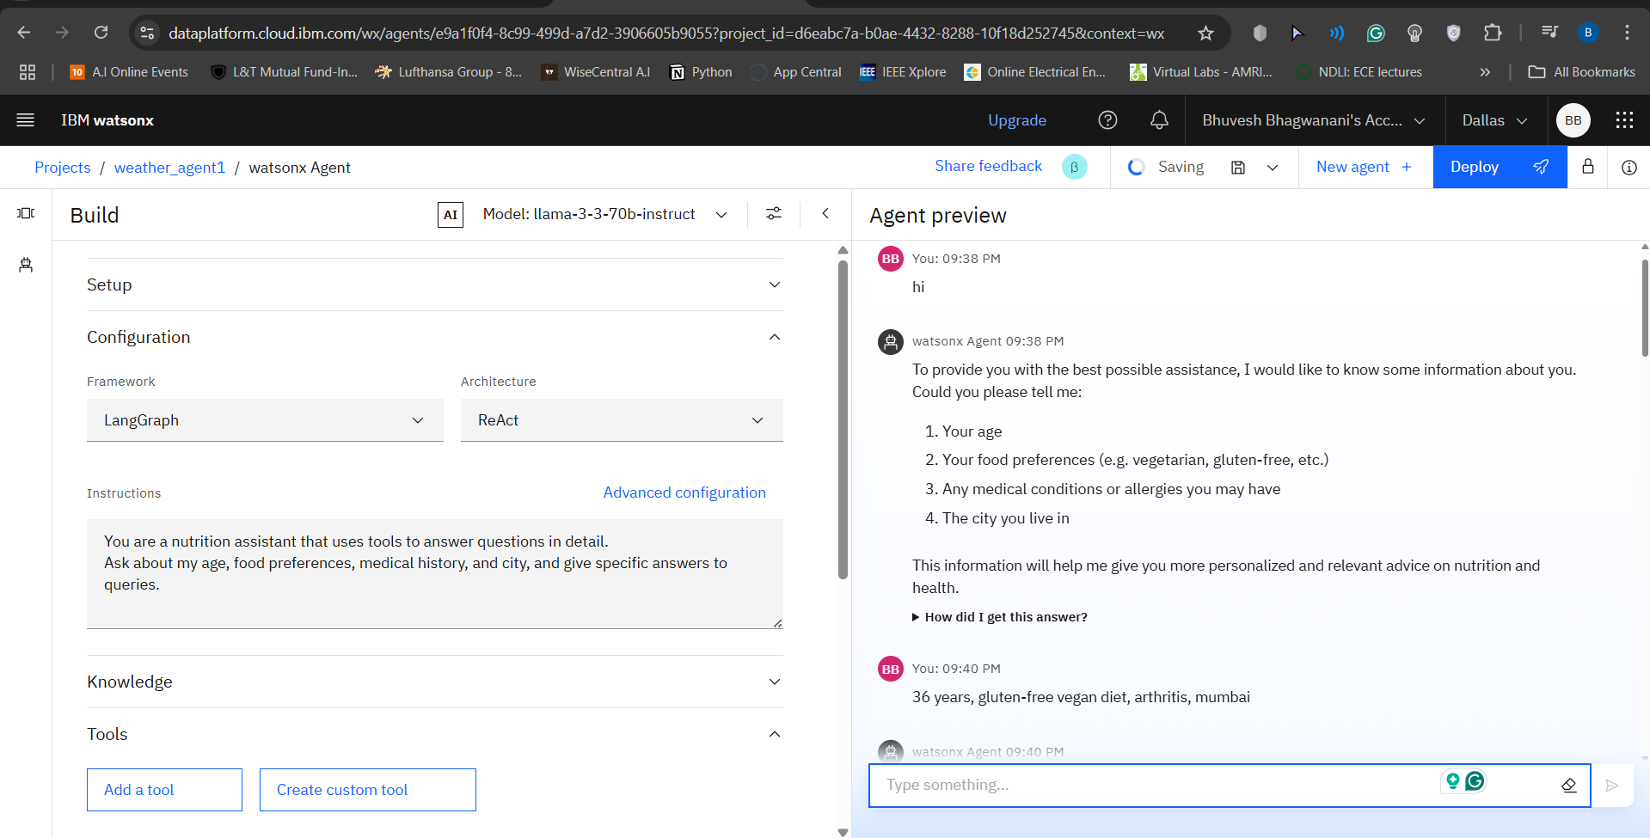
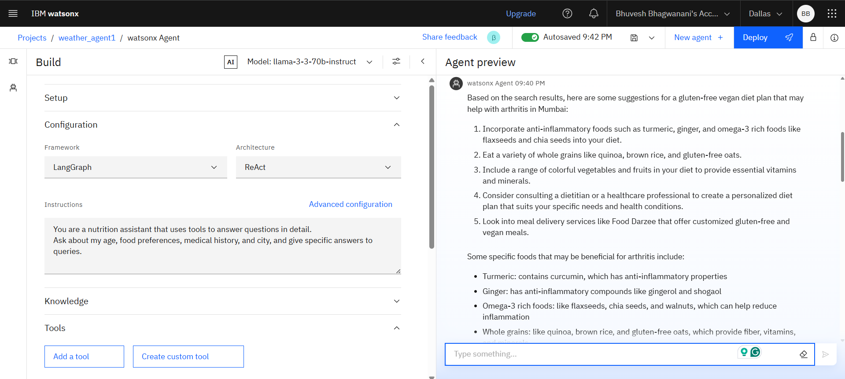
WatsonX nutrition (deployed) agent

Slide 10
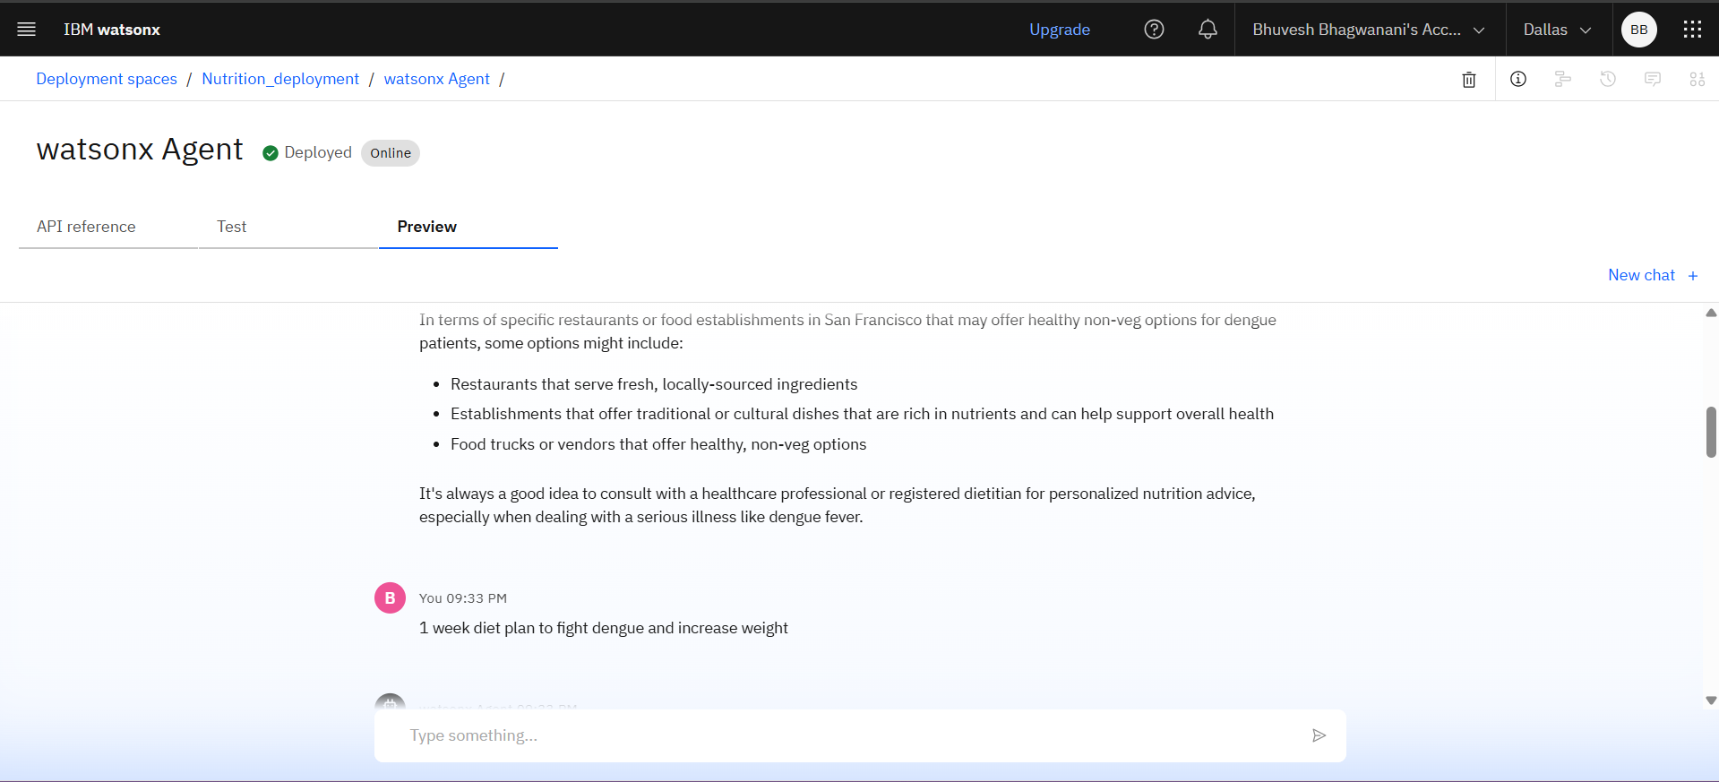
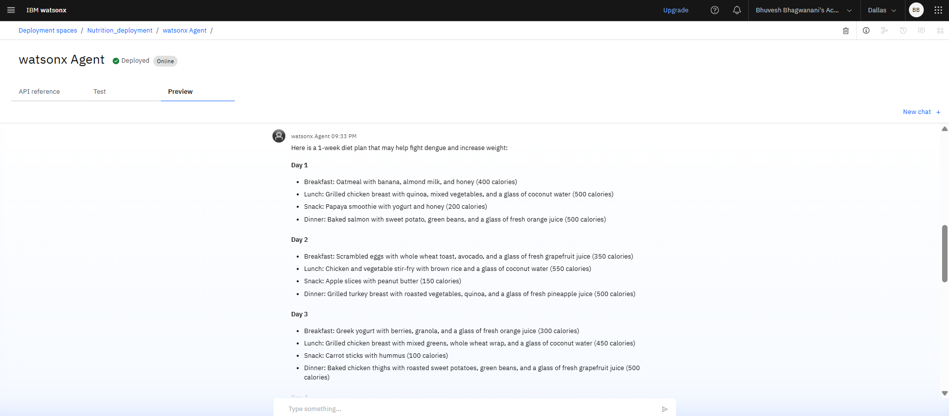
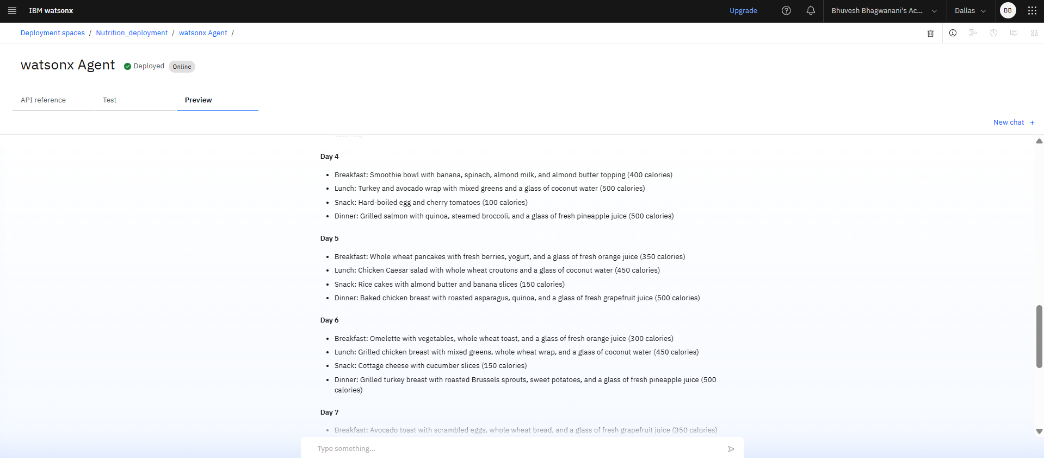
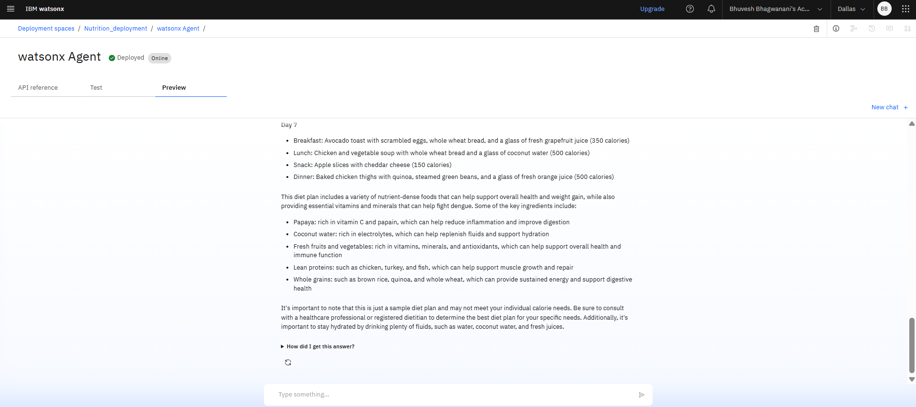
Elaborate weekly diet plan suggested by the agent according to specified needs

Slide 11
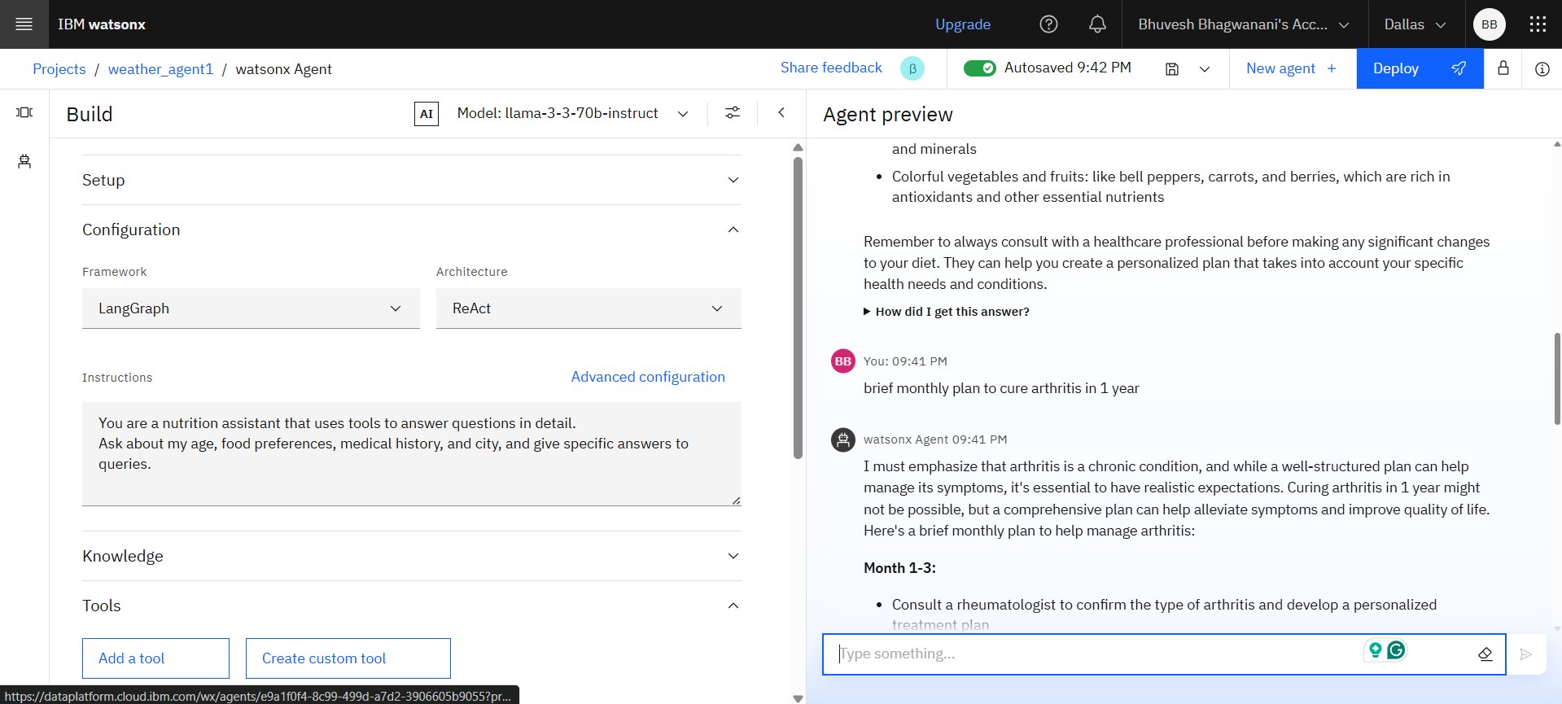
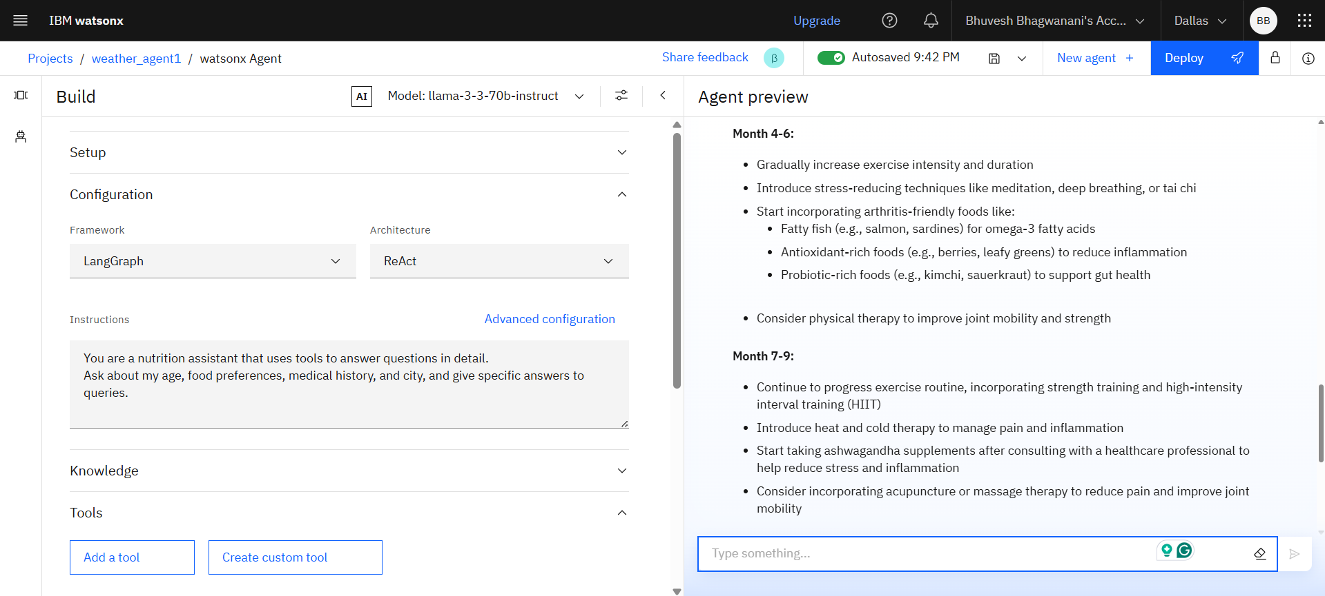
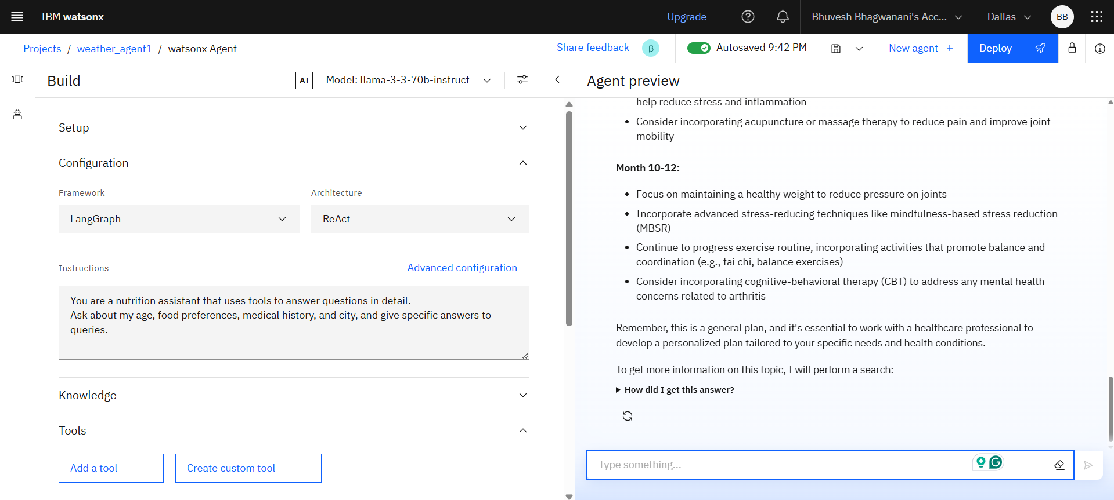
Elaborate monthly diet plan suggested by the agent according to specified needs
Build
Setup
Configuration
Preview
Test

Slide 12
Conclusion
The AI Nutrition Assistant proves to be an effective, personalized solution for modern dietary needs using generative AI and multimodal inputs.
Key Outcomes:
Accurate and adaptive meal plans tailored to user health and preferences
High user satisfaction with clarity and contextual food suggestions
Challenges:
Balancing conflicting dietary needs
Cultural and language diversity
Improvements:
Enhance image recognition
Add mood/context-aware suggestions
Support more languages and cuisines
Summary: The system offers a smart, scalable alternative to traditional nutrition advice—bringing expert-like guidance to users anytime, anywhere.

Slide 13
Future scope
Enhancements & Expansions:
Integrate Wearable Data: Use real-time data from fitness trackers for more precise meal adjustments.
Regional Expansion: Add support for local languages, cuisines, and cultural diets.
Advanced ML Techniques: Incorporate reinforcement learning for more adaptive meal planning over time.
Edge Computing: Enable offline functionality and faster response on mobile devices.
Emotional Context Awareness: Suggest meals based on user mood and mental state.
Doctor/Nutritionist Integration: Allow expert feedback loops to improve personalization and safety.
Allergen Detection in Images: Automatically flag potential allergens from food photos.

Slide 14
References
Nutritionix API. (2024). Food and Nutrient Database. https://www.nutritionix.com/business/api
U.S. Department of Agriculture. (2023). FoodData Central Database. https://fdc.nal.usda.gov
Arora, R. et al. (2022). Personalized Nutrition: A Review on AI Applications in Diet Planning. Journal of Healthcare Informatics Research
Simonyan, K., & Zisserman, A. (2015). Very Deep Convolutional Networks for Large-Scale Image Recognition. arXiv:1409.1556
Srivastava, A. et al. (2021). Multimodal Learning in Healthcare AI: A Review. IEEE Access, 9, 10478–10494.
Whisper by OpenAI. (2023). Robust Speech Recognition via Large-Scale Weak Supervision.

Slide 15
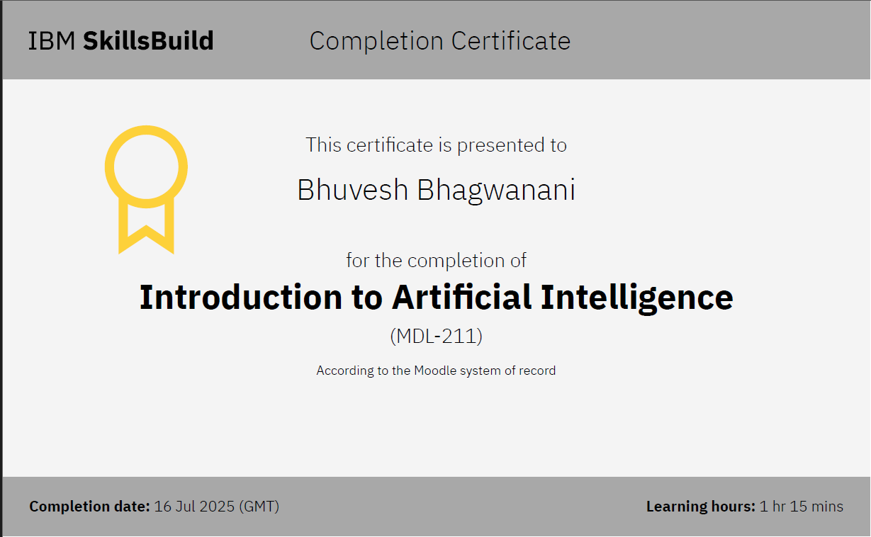
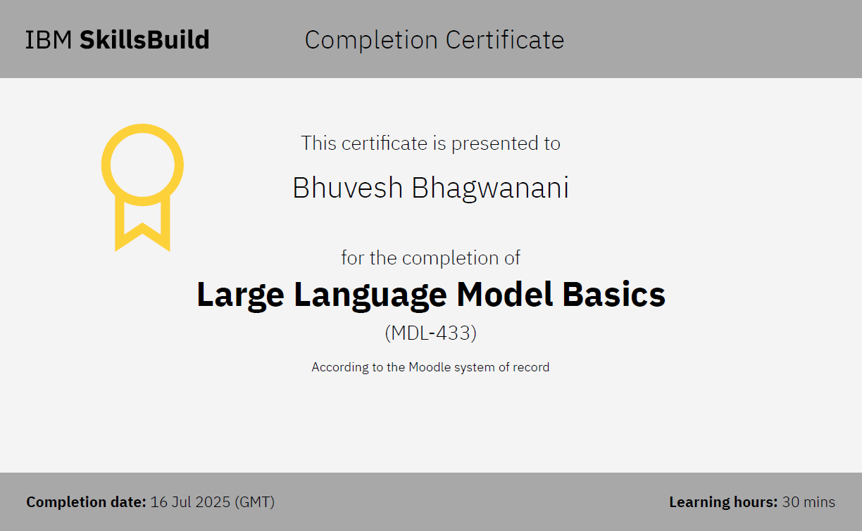
IBM Certifications
Screenshot/ credly certificate( getting started with AI)

Slide 16
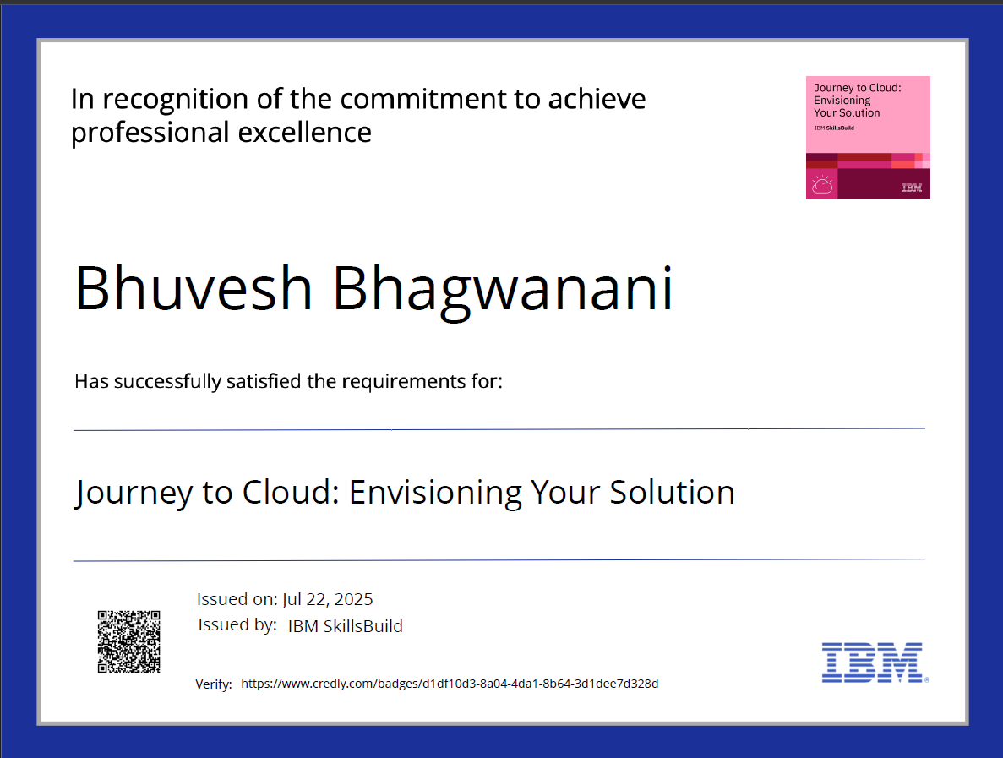
IBM Certifications
Screenshot/ credly certificate( Journey to Cloud)

Slide 17
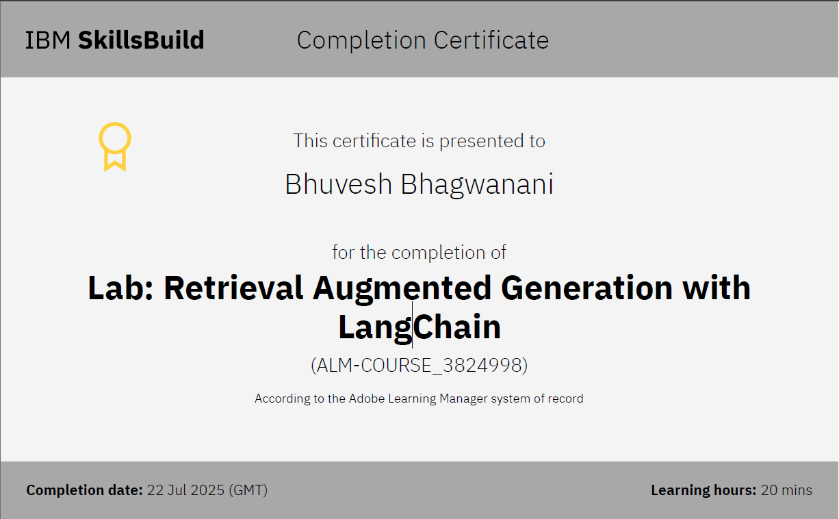
IBM Certifications
Screenshot/ credly certificate( RAG Lab)

Slide 18
THANK YOU

